Slide 1
Facial Keypoint Detection
Image Processing using Machine Learning

Slide 2
Why use Facial Keypoint Detection?
Facial recognition was first founded in the 1960s and just as it is in the name, it was used to recognize faces in pictures via computer.
When founded it was a labeled as a “man-machine” type of work since the humans had to input the coordinates of the facial features so that it could be used by the computer.
There doesn’t appear to be any clear motive for the discovery behind it more than just being able to use a computer to analyze pictures and recognize faces from it.
Now the we use the data set which is essentially coordinates of many main facial features such as the inner and outer part of both eyes, both ends of both eyebrows, the nose tip, and the left/right mouth corners, the center top and the center bottom lip. Reading these and the distances between them we are able to identify faces.
With this information we are able to do many different things, helpful for medical and helpful for the government. We can track faces in images and videos, usage in biometrics which can be things such as opening your iphone with your face, we can analyze facial expressions, as well as dysmorphic facial signs for diagnosis.

Slide 3
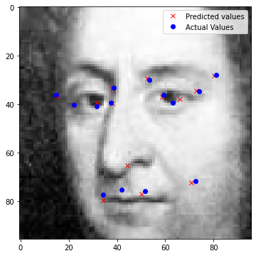
The Data
What is being analyzed.
1783 test images.
Where the data comes from.
7049 images.
What the data is.
15 key points in (x,y) coordinates.

Slide 4
Keypoint Detection Problems
Detecting facial keypoints is a very challenging problem. Facial features vary greatly from one individual to another, and even for a single individual, there is a large amount of variation due to 3D pose, size, position, viewing angle, and illumination conditions.
It can be difficult to deploy most of these techniques and methods due to the fact that AI inference requires a considerable amount of processing power, especially in a real-time data-intensive application. Hence, the cloud is not an adequate environment for deploying scalable AI.
The complexity of most Computer Vision problems causes most organizations to fail at scaling this visual AI even with the promise of great hardware support for Edge deployments.
Computer vision research has come a long way in addressing these difficulties, but there remain many opportunities for improvement.

Slide 5
What type of problem is this?
This problem is a classification-supervised learning problem.
Image Processing through Machine Learning is a supervised problem because we have the algorithm learn from a certain dataset; we know what the answers should be, and we supervise and correct the algorithm in order for it to produce our expected results.
This type of problem also falls under a classification problem since the output variable, or the expected result can be classified into a certain classes, such as “left eye”, “right eye”, “mouth”, etc.
In contrast to classification problems, there exists regression problems, in which the expected result is classified into real values such as dollar amounts, weight amounts, etc.

Slide 6
Why we chose Facial Keypoint Detection
Matt- I chose this because compared to the other topics this one seemed more interesting plus I thought that it would be interesting as to how they actually recognize faces and the knowledge behind how it works.
Alex-I find both image processing and algorithms interesting.
Max - As an Applied Mathematics major, I want see how certain algorithms and techniques are used within the scope of machine learning.
Austin - I chose this problem to research, because I’ve always been interested in attempting to discover how computer vision works and how a Neural Network can be trained using images. I know there exists a lot of challenges and problems to face in this field, so I’m interested to see what kind of progress can be made.

Slide 7
Thank You For Your Time!

